Slide 1

Git and GitHub Introduction
By Velocity

Slide 2
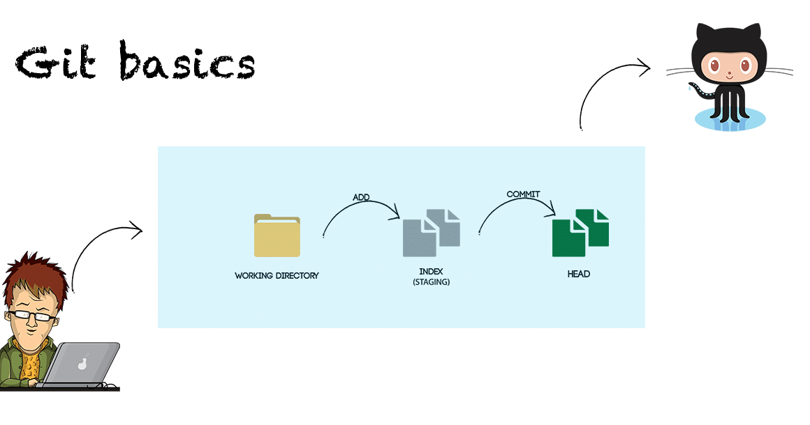
Part 1 :Basic Concepts

Slide 3
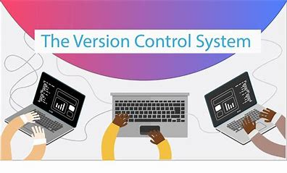
What is Version Control System (VCS)?
Version Control Systems are the software tools for tracking/managing all the changes made to the source code during the project development.
It keeps a record of every single change made to the code. It also allows us to turn back to the previous version of the code if any mistake is made in the current version.
Without a VCS in place, it would not be possible to monitor the development of the project.

Slide 4
Types of version Control system
1.Centralized Version Control System
2.Distributed Version Control System

Slide 5
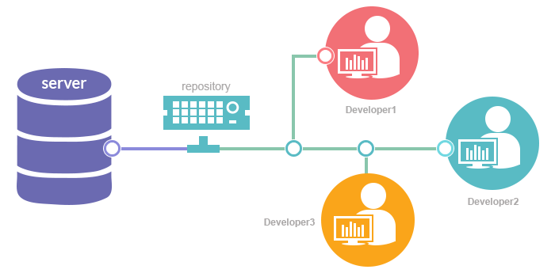
1.Centralized Version Control System:
In the Centralized Version Control Systems, there will be a single central server that contains all the files related to the project, and team members can download the files from this single server that he wants to change and after doing the work simply upload them to the server.
The problem with the Centralized Version Control Systems is if the central server crashes, almost everything related to the project will be lost.

Slide 6
2.Distributed Version Control System
In a distributed version control system, there will be one or more servers and many team members similar to the centralized system. But the difference is, not only do they will download the latest version, but each member will have an exact copy (mirroring) of the main repository (including its entire history) on their local machines.
Each user has their own repository and a working copy. This is very useful because even if the server crashes, we would not lose everything as several copies are residing in several other computers.

Slide 7
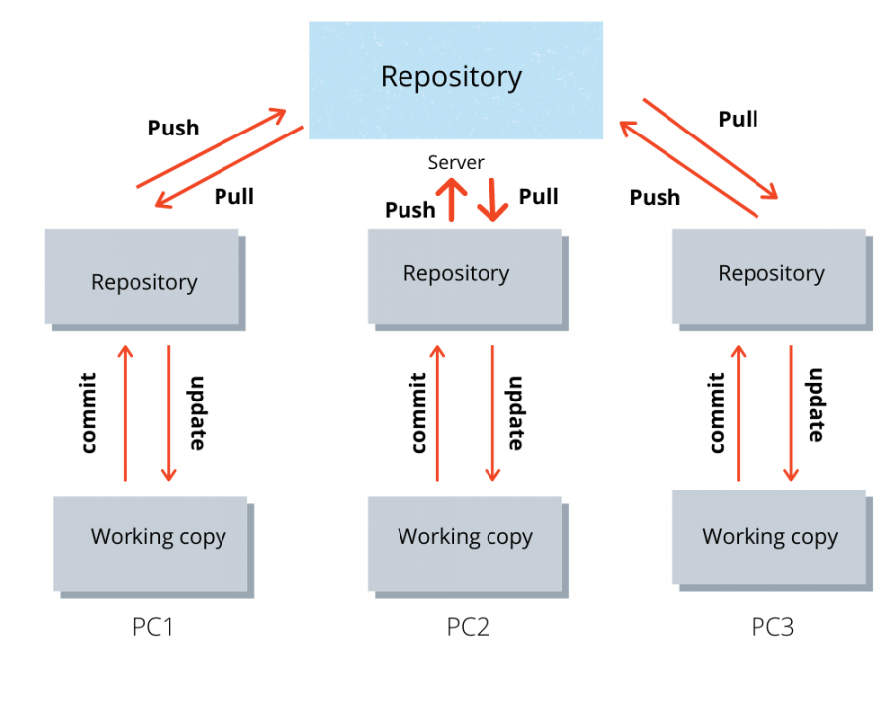

Slide 8
Why do we need Version Control System?
When multiple team members work on the same project, it is essential to have version control for the program. Version control system helps the team to share changes and merge changes made to artifacts seamless and efficient.
VCS improves the following factors:
1.Collaboration
2.Storing Versions
3.Backup
4.Improves visibility
5.Accelerate product delivery

Slide 9
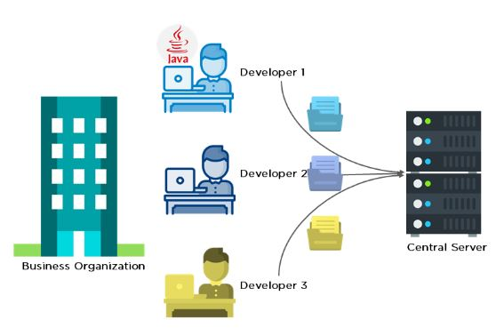
Before diving deep, let’s explain a scenario before Git:
i. Developers used to submit their codes to the central server without having copies of their own.
ii. Any changes made to the source code were unknown to the other developers.
iii. There was no communication between any of the developers.

Slide 10
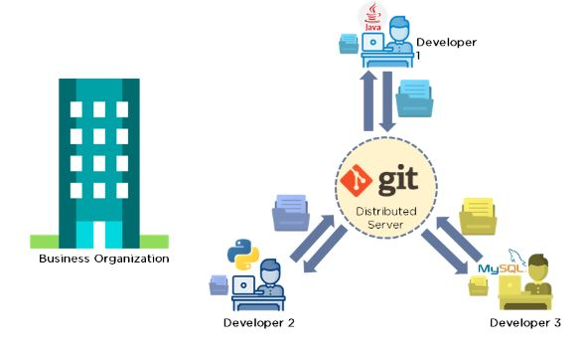
Now let’s look at the scenario after Git:
i. Every developer has an entire copy of the code on their local systems
ii. Any changes made to the source code can be tracked by others
iii. There is regular communication between the developers

Slide 11
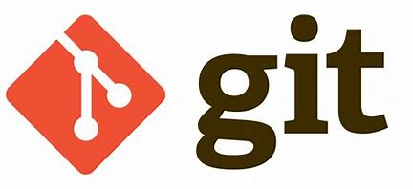
What is Git?
Git is a most commonly used distributed version control system. It was created by Linus Torvalds in 2005, and has been maintained by Junio Hamano since then.
It is used for:
Tracking code changes
Tracking who made changes
Coding collaboration

Slide 12
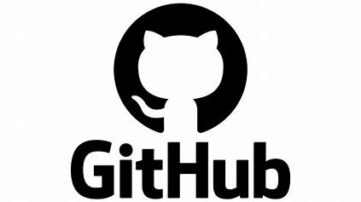
What is GitHub?
GitHub is a cloud based open-source repository hosting service, it is a web-based interface that uses Git, an open-source version control system.
It maintains track of the modifications made to each iteration of your source code projects in a variety of programming languages.

Slide 13
